Slide 1

Exploratory Data Analysis of Historical Indian Weather Data for Prediction and Installation of Sustainable Sources of Energy by using ML and Deep Learning
SRM INSTITUTE OF SCIENCE AND TECHNOLOGY
SCHOOL OF COMPUTING
DEPARTMENT OF COMPUTING TECHNOLOGIES
18CSP107L / 18CSP108L - MAJOR PROJECT / INTERNSHIP
Guide Name: Dr. S. Poornima
Designation: Assistant Professor Department: Department of Computing Technologies, College of Engineering & Technology, Kattankulathur - Chennai
Batch ID: B165
Student 1 Reg. No: RA1911003010811
Student 1 Name: HRIDAY ANAND
Student 2 Reg. No: RA1911003010812
Student 2 Name: DHARVA KHAMBHOLIA

Slide 2
ABSTRACT
Exploratory Data Analysis (EDA) is one of the hidden and mundane tasks in analysis of Data, as a Model, Project or analysis is based on data, which is intuitive, extremely heterogeneous and distorted in its form. (Data has become an integral part of every project and models.)
The analyzed data is more insightful for identifying and improving extremely critical business insights across the Organization.
This project will define the exploratory data analysis phenomenon in detail and also would state its role in the data analysis domain.
Tools & Packages used in EDA are also discussed. In addition, the impact of missing out the phase of EDA in data analysis has been analyzed.
EDA can also help with preparing and visualizing data in a manner that helps us to implement other data processing techniques such as Deep Learning and Machine Learning.

Slide 3
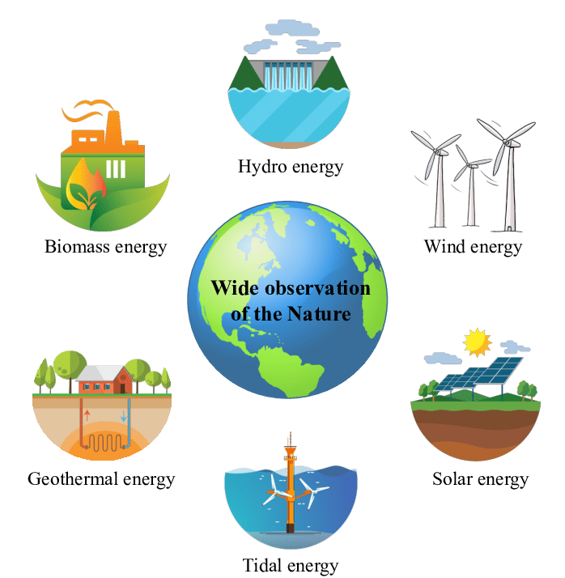
INTRODUCTION
Sustainable development is a key part in the evolution and sustenance of the human kind. It is absolutely essential that we understand the consequences of our actions and pay attention the carbon emission and global warming national index.
Using Sustainable Power Generation sources like solar panels, wind mills, dams etc can be very beneficial in the future to convert our civilization into a carbon emission free planet.
EDA of historic weather data can be used to train a model and achieve a accurate prediction model.
This model can be used to analyze and use the output metrics to evaluate satellite imagery to obtain a land mass/area that energy plants can be installed.

Slide 4
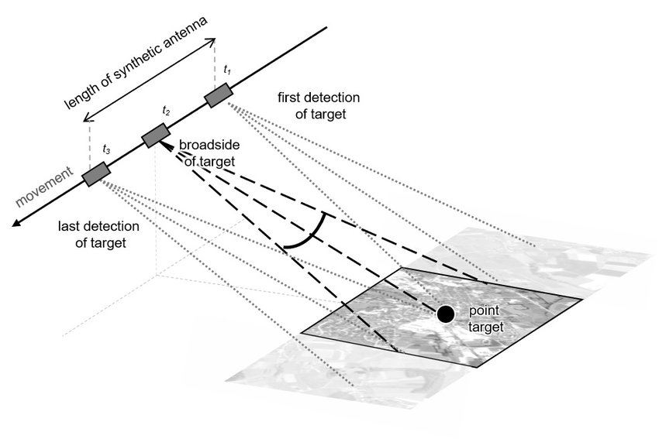
EXISTING SYSTEM
The current system used is SAR which is Synthetic Aperture Radar which is well suited for satellite imagery and mapping since its use of microwaves allows it to image both day and night and in near-all weather conditions. But they are still prone to disadvantages such as :
High speckle noise
Shadows
Distortions
Uneven grayscale distribution
Existence of external Interference factors.

Slide 5
PROBLEM STATEMENT AND OBJECTIVES OF THE PROJECT
The objective of this project is to create a semantic segmentation model that can identify empty landmasses and regions accurately and efficiently while addressing the limitations of the conventional segmentation systems.
We plan of leveraging 2 deep learning algorithms, UNET and DeepLabV3 in order to create a model that can produce results quickly. By using EDA and a Machine Learning model to read datasets and predict values for temp, precipitation and wind speed we feed that information to the deep learning models to get a accurate visualisation of the recommended land plots where installation of sustainable sources of energy can be done.
Overall, this project aims to use state-of-art algorithms and architectures that can handle challenges of identifying required landmasses that fit into our requirements using satellite imagery.

Slide 6
LITERATURE SURVEY
The topic of forecasting the weather has been the subject of numerous research articles. The weather forecast using data mining research based on cloud computing was the subject of a publication. This article suggests a contemporary approach to creating a service-oriented architecture for meteorological information systems that forecast weather utilising these methods for data mining.
In another research titled "Analysis on The Weather Forecasting and Techniques," it was determined that fuzzy logic and artificial neural networks offer the greatest comparable solutions and predictions. They made the decision to take into account a number of factors, including temperature, humidity, pressure, wind, and others.
The surveyed literatures evident that processes adapted by the data science professionals, in analyzing the need of hour tend to ignore the EDA Process to stay ahead with the timelines. Hence, from many inferences, it is evidently proven that EDA can have significant impact in modeling algorithms, ignoring the same may lead to inaccurate predictions and re-working. As a resultant increase in the overhead cost and resource utilization is observed on the whole.

Slide 7
LITERATURE SURVEY
“The predictive or machine learning problem is easy to state if difficult to solve in general” as mentioned in a research article on Recent Advances in Predictive (Machine) Learning by Jerome H. Friedman Department of Statistics and Stanford Linear Accelerator Center, Stanford University ; gives us numerous insights on the topic of Forecasting. Decision trees are the most popular predictive learning method used in data mining.[see Breiman, L., Friedman, J. H., Olshen, R. and Stone, C. (1983). Classification and Regression Trees. Wadsworth.]
If little is known about which technique might be best in any given application, several can be tried and effectiveness judged on independent data not used to construct the respective learning machines under consideration. [Friedman, Jerome. (2006). Recent Advances in Predictive (Machine) Learning. Journal of Classification. 23. 175-197. 10.1007/s00357-006-0012-4. ]

Slide 8
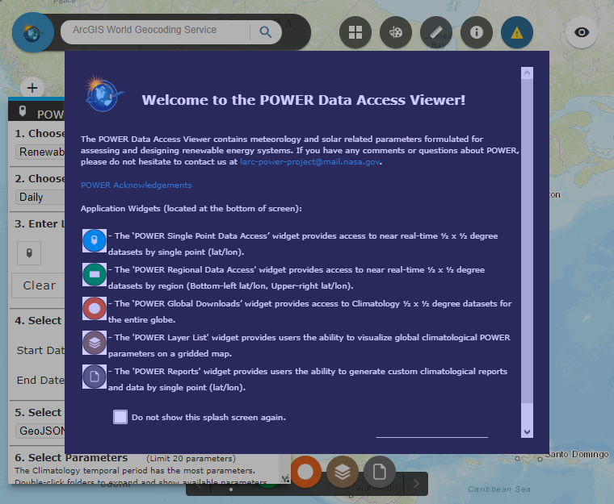
DATASET
Using The POWER Data Access Viewer :
https://power.larc.nasa.gov/data-access-viewer/
It is a government based website which contains meteorology and solar related parameters formulated for assessing and designing renewable energy systems.
The POWER Data Access viewer is associated with NASA.
The dataset contains weather values from the time the website was established i.e. 1990-current.
Data can be extracted from the website by inputting specific Latitude and Longitude values and the Data can be extracted in the form of a .csv file which we use to run EDA and train the model in Jupyter Notebook.
After training the model using Ridge Regression and running it through classifiers and applying other parametrics, we need to get a dataset for training another model for image segmentation. We obtain the dataset from kaggle.

Slide 9
FLOW OF THE PROJECT
Obtain the Dataset.
Clean and verify the viability of the dataset by using libraries such as pandas in python.
Use different algorithms to code the models.
Add Parameters to the model to improve accuracy.
Obtain the Top 5 cities that are most viable for installation of Solar Panels and windmills based on the value predictions of the model.
Obtain a dataset for satellite imagery from kaggle.
Generate a image segmentation model using UNET to be trained using the above mentioned dataset.
Feed the Satellite Images of the Top 5 Categorized cities and Generate the required Information using the Deep Learning Model.

Slide 10
INNOVATION IDEA OF THE PROJECT AND BENEFITS
The aim is to suggest locations for possible implementation of solar panels, windmills etc based on the results from the ML prediction model. The successful implementation of this project can lead to various benefits as this project can be used to further the cause of sustainable energy development and spread awareness about the harmful effects that fossil fuels have on our planet.

Slide 11
SCOPE AND APPLICATION OF THE PROJECT
Viable Installation-Site Mapping
Furthers the cause of Sustainable Development
Reduction in the usage of Fossil Fuels and production of clean eco-friendly Green Energy.
Accurate Estimates of weather prediction with parameters including Temperature, Wind Speed at 50M, Precipitation (in inches) and Surface Pressure. Further implementation of this project will try to include Solar Flux and Radiation as a parameter too to improve the Prediction of sites for Solar Panel Plants.

Slide 12
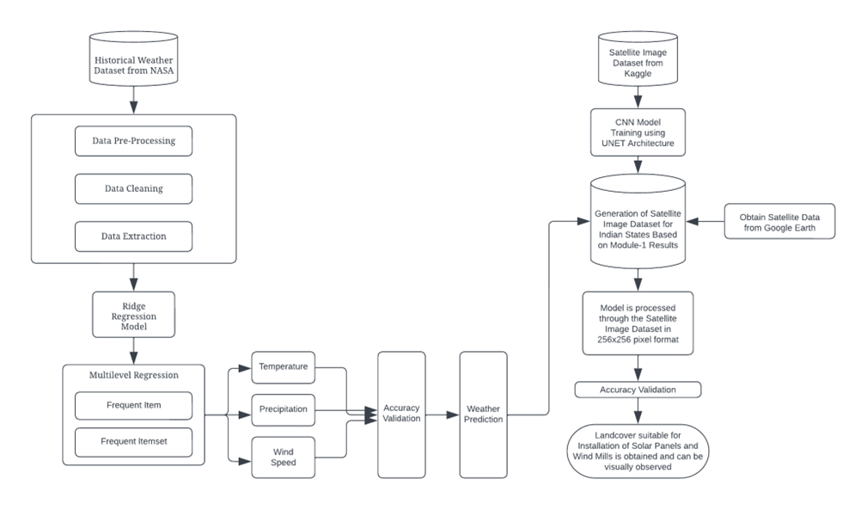
Architecture Diagram of the proposed work

Slide 13
PROPOSED MODULES (ALGORITHMS USED)
This project consists of two sectors in which different algorithms are going to be implemented. In the first part of the project we will be using Machine Learning to develop a model that uses historical data to predict the weather accurately by using Ridge Regression.
For the second section of our project we’ll be using Deep Learning algorithms and implement CNN by using UNET in order to implement image segmentation measures.
We’ve also used Pre-processing and Visualisation Methods such as Pandas, Matplotlib, Folium, sklearn etc in Python.

Slide 14
PROPOSED MODULES
Ridge Regression -
Ridge Regression is a model tuning method that is used to analyse data that suffers from multicollinearity and it performs L2 Regularization. Multicollinearity can be defined as the presence of high correlations between two or more independent variables (predictors). This algorithm helps the model to accurately predict values by gauging the weights and adding a penalty parameter of lambda. In Python we use the term ‘alpha’ as lambda is an inbuilt function.
UNET -
U-Net in keras is a convolutional neural network that was developed for biomedical image segmentation. The network is based on the fully convolutional network and its architecture was modified and extended to work with fewer training images and to yield more precise segmentations.
The main idea is to supplement a usual contracting network by successive layers, where pooling operations are replaced by upsampling operators. Hence these layers increase the resolution of the output. A successive convolutional layer can then learn to assemble a precise output based on this information.

Slide 15
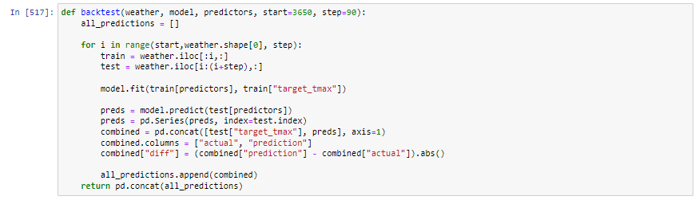
IMPLEMENTING THE RIDGE REGRESSION ALGORITHM FROM SKLEARN
CODING THE BACKTEST() FUNCTION WHICH WILL BE USED TO TRAIN THE MODEL

Slide 16
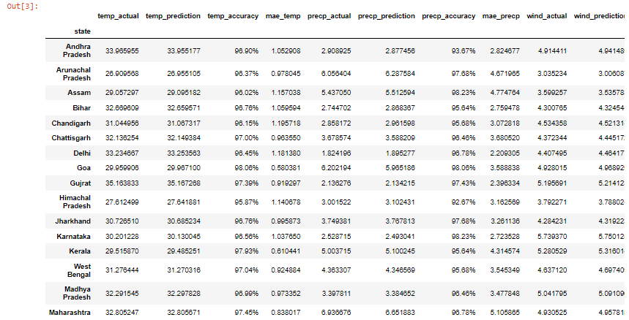
OUTPUT
OUTPUT DATAFRAME IS OBTAINED WHICH CONSISTS OF ATTRIBUTES SUCH AS ACTUAL AND PREDICTED VALUES OF THE METRICS ALONG WITH MEAN ABSOLUTE ERROR VALUES

Slide 17
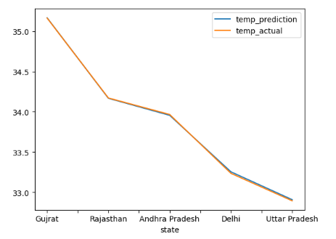
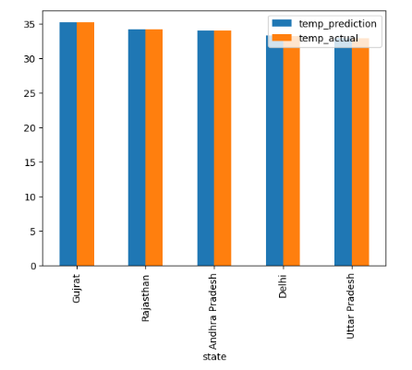
OUTPUT GRAPHS
RESULTANT STATES SUITABLE FOR SOLAR PANEL INSTALLATION
Gujrat
Rajasthan
Andhra Pradesh
Delhi
Uttar Pradesh

Slide 18
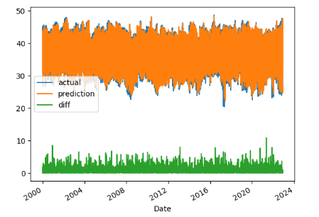
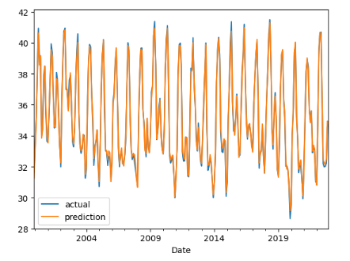
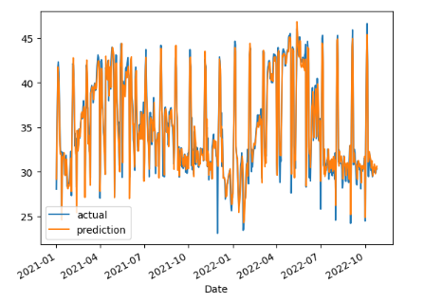
OUTPUT GRAPHS for States Suitable for Solar Panel Installation
GUJRAT

Slide 19
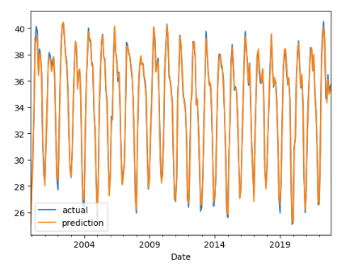
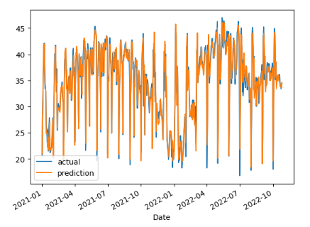
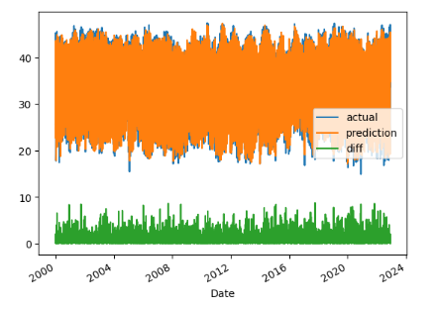
OUTPUT GRAPHS for States Suitable for Solar Panel Installation
RAJASTHAN

Slide 20
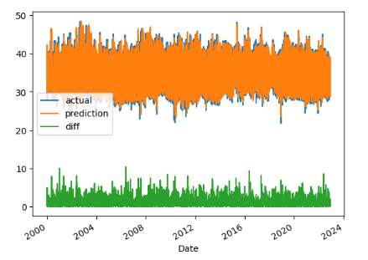
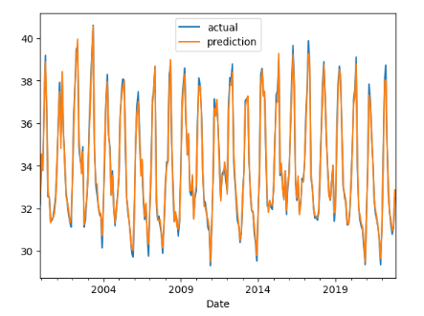
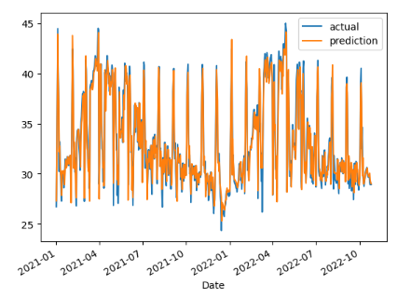
OUTPUT GRAPHS for States Suitable for Solar Panel Installation
ANDHRA PRADESH

Slide 21
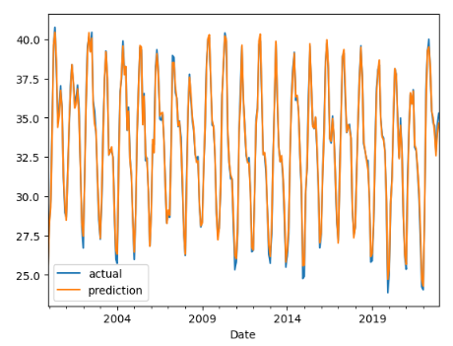
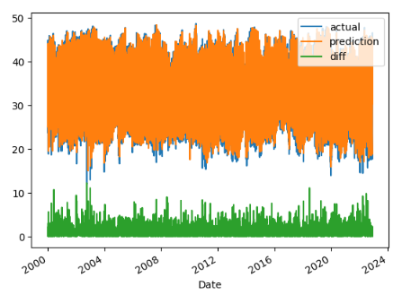
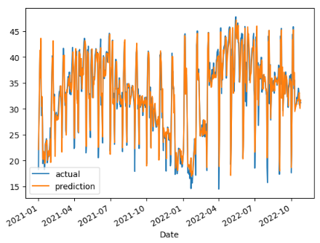
OUTPUT GRAPHS for States Suitable for Solar Panel Installation
DELHI

Slide 22
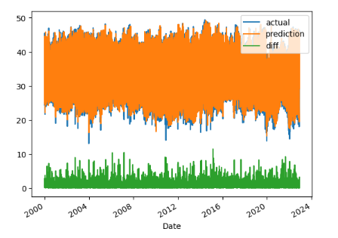
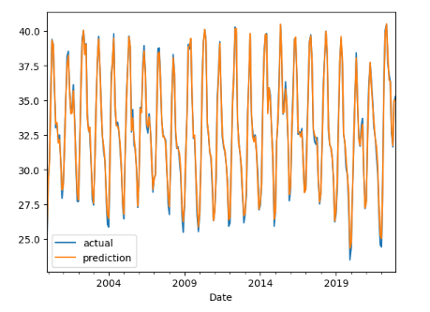
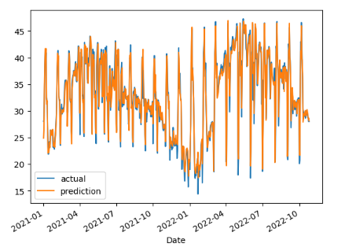
OUTPUT GRAPHS for States Suitable for Solar Panel Installation
UTTAR PRADESH

Slide 23
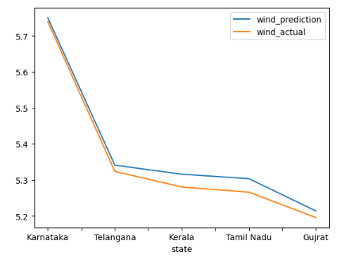
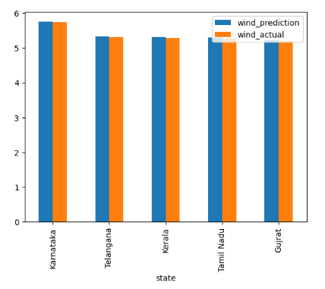
OUTPUT GRAPHS
RESULTANT STATES SUITABLE FOR WIND-MILL INSTALLATION
Karnataka
Telangana
Kerala
Tamil Nadu
Gujrat

Slide 24
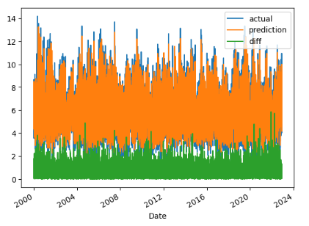
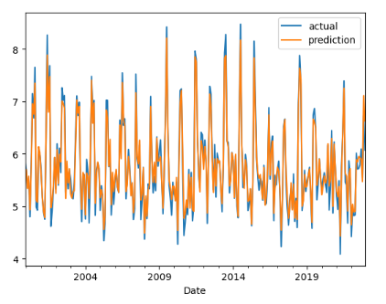
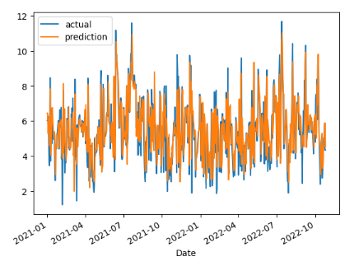
OUTPUT GRAPHS for States Suitable for Wind-Mill Installation
KARNATAKA

Slide 25
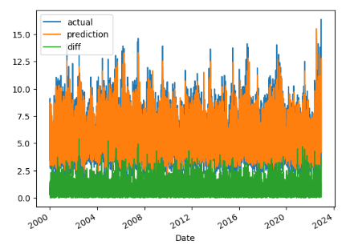
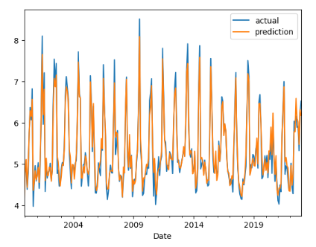
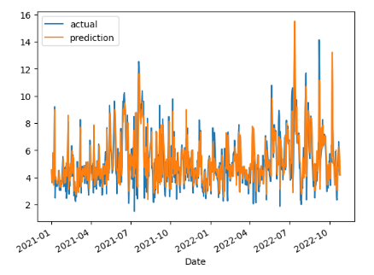
OUTPUT GRAPHS for States Suitable for Wind-Mill Installation
TELANGANA

Slide 26
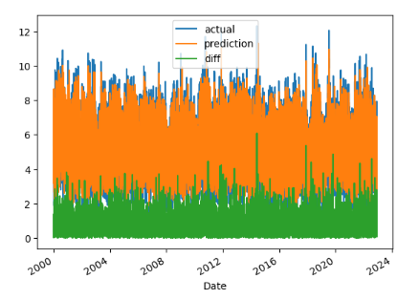
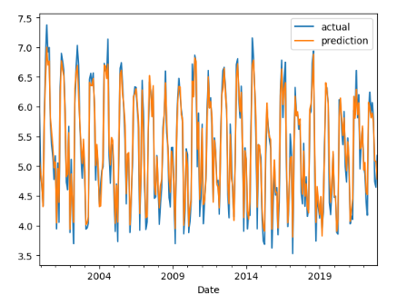
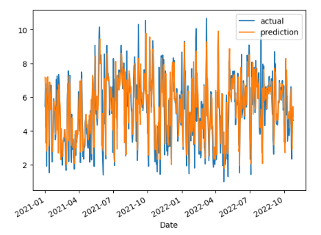
OUTPUT GRAPHS for States Suitable for Wind-Mill Installation
KERALA

Slide 27
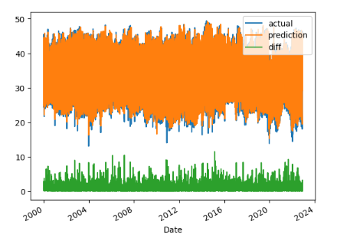
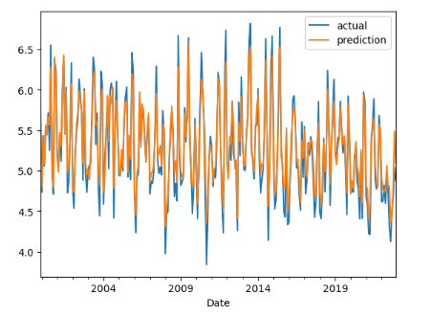
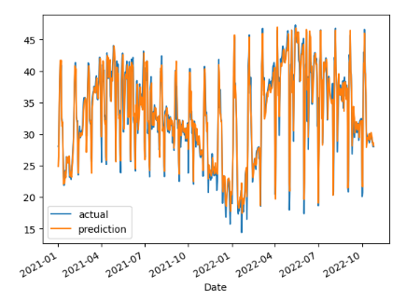
OUTPUT GRAPHS for States Suitable for Wind-Mill Installation
TAMIL NADU

Slide 28
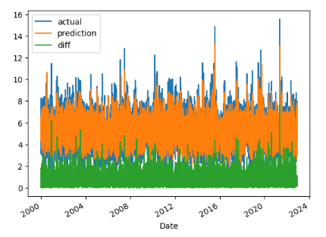
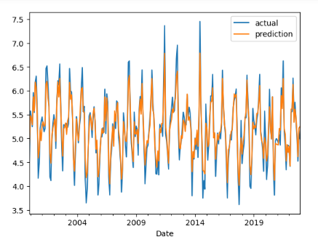
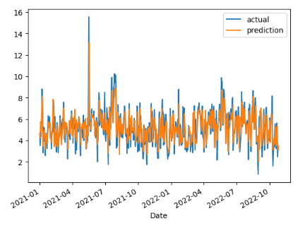
OUTPUT GRAPHS for States Suitable for Wind-Mill Installation
GUJRAT

Slide 29
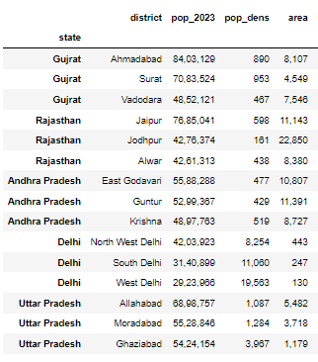

OUTPUT
DATA-FRAME CONSISTING OF DATA ON TOP 3 POPULATION DENSE REGIONS FOR STATES ELIGIBLE FOR SOLAR PANEL INSTALLATION
This data is obtained from the website :
https://www.indiacensus.net

Slide 30
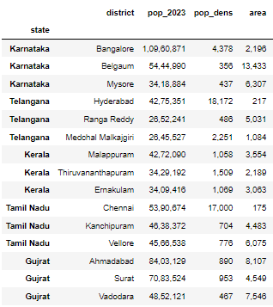
OUTPUT
DATA-FRAME CONSISTING OF DATA ON TOP 3 POPULATION DENSE REGIONS FOR STATES ELIGIBLE FOR WIND-MILL INSTALLATION
This data is obtained from the website :
https://www.indiacensus.net

Slide 31
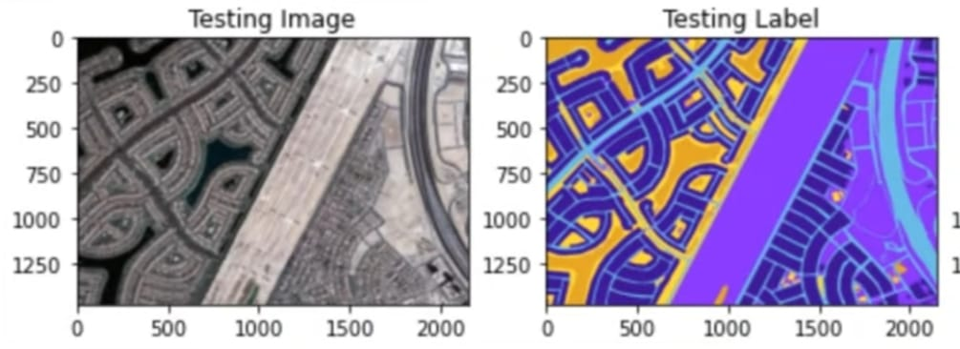
PROPOSED MODULES
UNET -

Slide 32
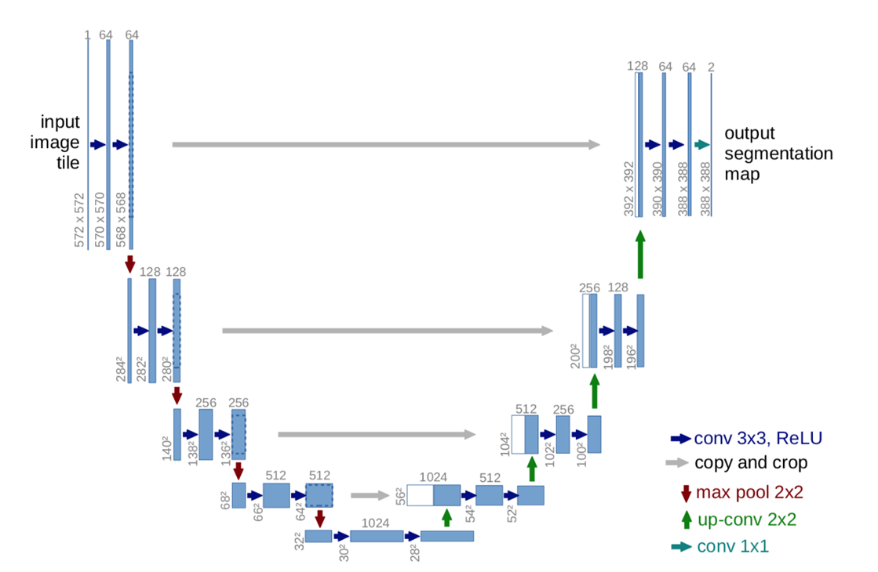
PROPOSED MODULES
UNET -

Slide 33
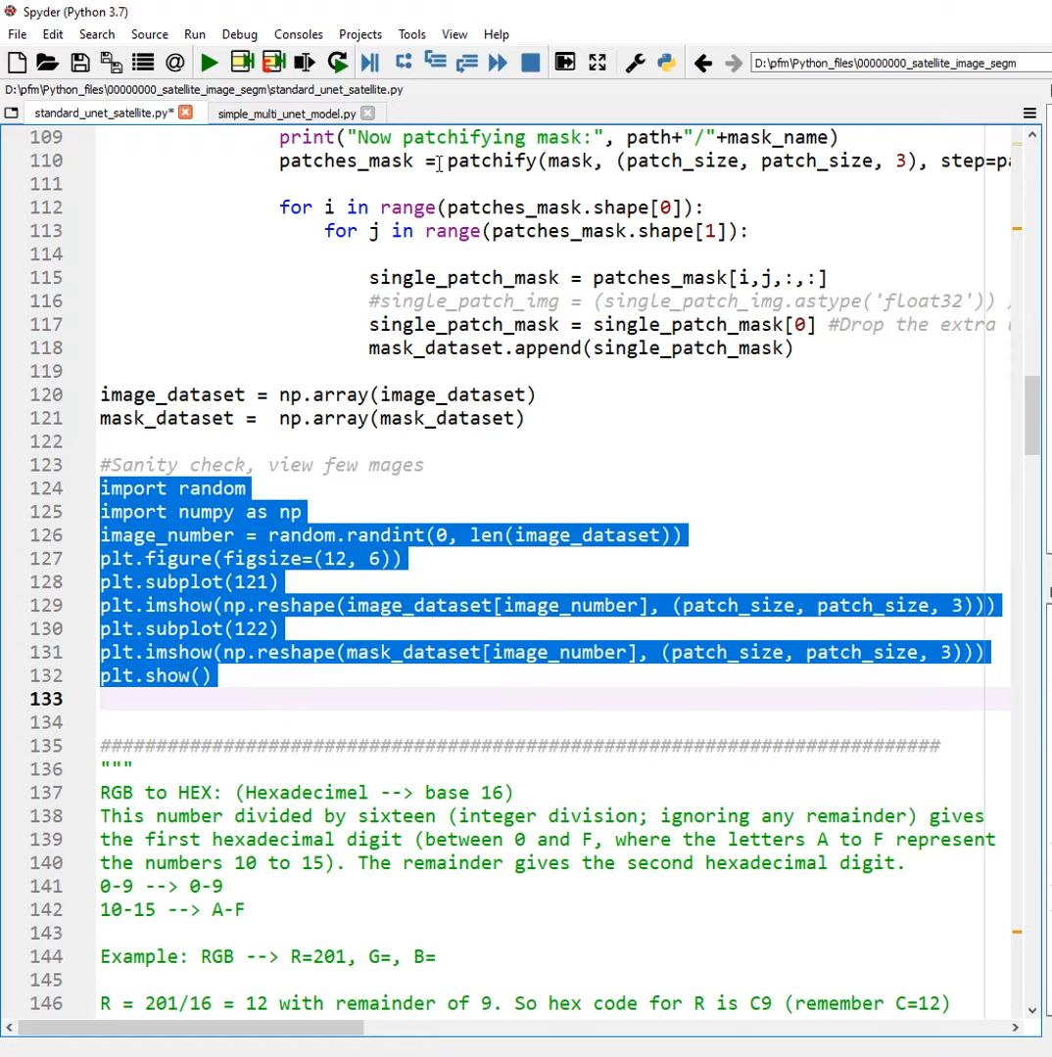
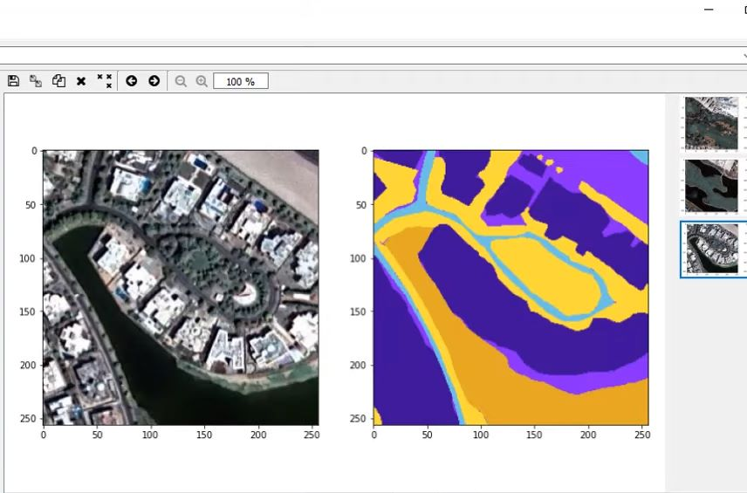
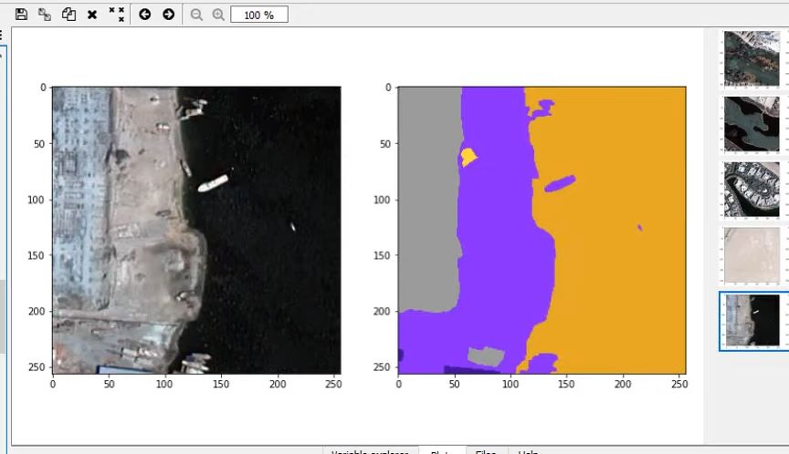
TESTING MODULE

Slide 34
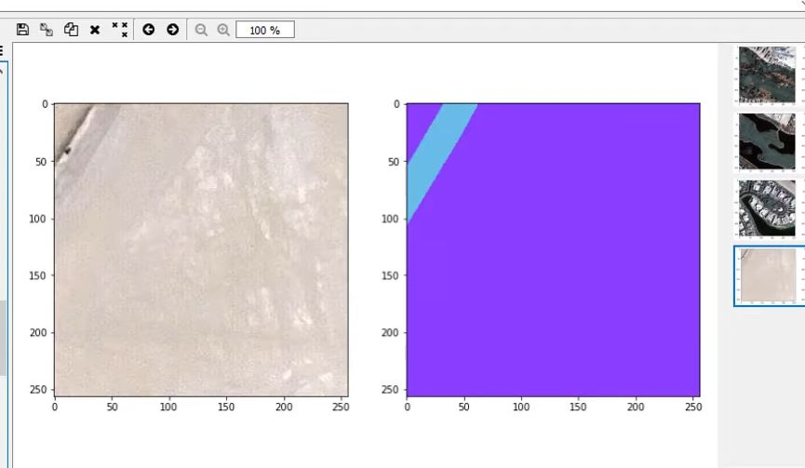
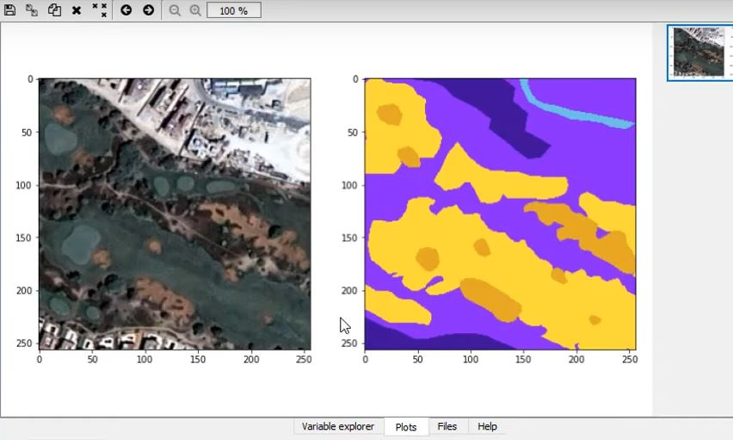
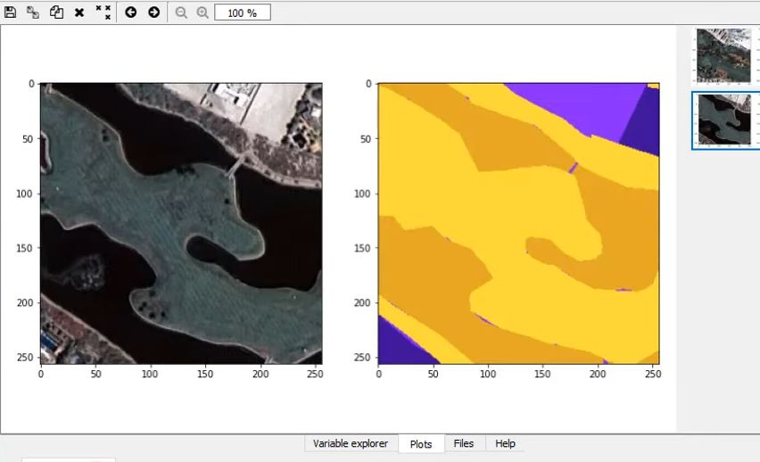
TESTING MODULE

Slide 35



OUTPUT SCREENSHOTS

Slide 36

OUTPUT SCREENSHOTS

Slide 37
RESULTS
Our Main model gives an average testing accuracy of 96.2%. The Ridge Regression model accuracy of the testing and training data is exceptionally high for the prediction of temperature metrics of each state.
The ridge regression model also provided an exceptionally high accuracy for the precipitation and wind predictions.
Able to successfully predict the metrics and train the model effectively in order to get the output of the states that would be the most viable for the installation of Solar Panels and Windmills (Sustainable sources of Energy).

Slide 38
FUTURE IMPROVEMENTS AND IMPLEMENTATIONS
Furthermore we’ll try to implement Random Forest Regression, KNN, XGBoost etc to compare which model gives better results in the machine learning module (prediction module).

Slide 39
MAJOR LIBRARIES USED IN THE PROJECT
We'll use the the python libraries pandas, matplotlib, plotly and folium to do exploratory data analysis on the weather dataset.
Pandas -
The quality of data is the most crucial element of any business intelligence strategy. Data cleaning is the process of fixing or removing incorrect, corrupted, incorrectly formatted, duplicate, or incomplete data within a dataset. This will be done using pandas.
Matplotlib and Plotly-
Matplotlib is a quick and straightforward tool for creating visualizations within Python. The verbosity required to make anything more than a basic plot makes it more suitable for an initial exploratory analysis or a minimalist design. Matplotlib is also a great place for new Python users to start their data visualization education, because each plot element is declared explicitly in a logical manner.
Plotly, on the other hand, is a more sophisticated data visualization tool that is better suited for creating elaborate plots more efficiently. The interactivity and elegant aesthetics that come with plotly are benefits that cannot be ignored.

Slide 40
MAJOR LIBRARIES USED IN THE PROJECT
We'll use the the python libraries pandas, matplotlib, plotly and folium to do exploratory data analysis on the weather dataset.
Folium -
Folium is a powerful Python library that helps you create several types of Leaflet maps. By default, Folium creates a map in a separate HTML file. Since Folium results are interactive, this library is very useful for dashboard building. You can also create inline Jupyter maps in Folium.
Scikit-learn(sklearn) -
sklearn is a free software machine learning library for the Python programming language. It features various classification, regression and clustering algorithms including support-vector machines, random forests, gradient boosting, k-means and DBSCAN, and is designed to interoperate with the Python numerical and scientific libraries NumPy and SciPy.

Slide 41
MAJOR LIBRARIES USED IN THE PROJECT
CatBoost -
Categorical Boosting is an open-source boosting library developed by Yandex. In addition to regression and classification, CatBoost can be used in ranking, recommendation systems, forecasting and even personal assistants.
The XGBoost (eXtreme Gradient Boosting) is a popular and efficient open-source implementation of the gradient boosted trees algorithm. Gradient boosting is a supervised learning algorithm that attempts to accurately predict a target variable by combining an ensemble of estimates from a set of simpler and weaker models.

Slide 42
THANK YOU
RA1911003010811 (Hriday Anand)
RA1911003010812 (Dharva Khambolia)

